Slide 1
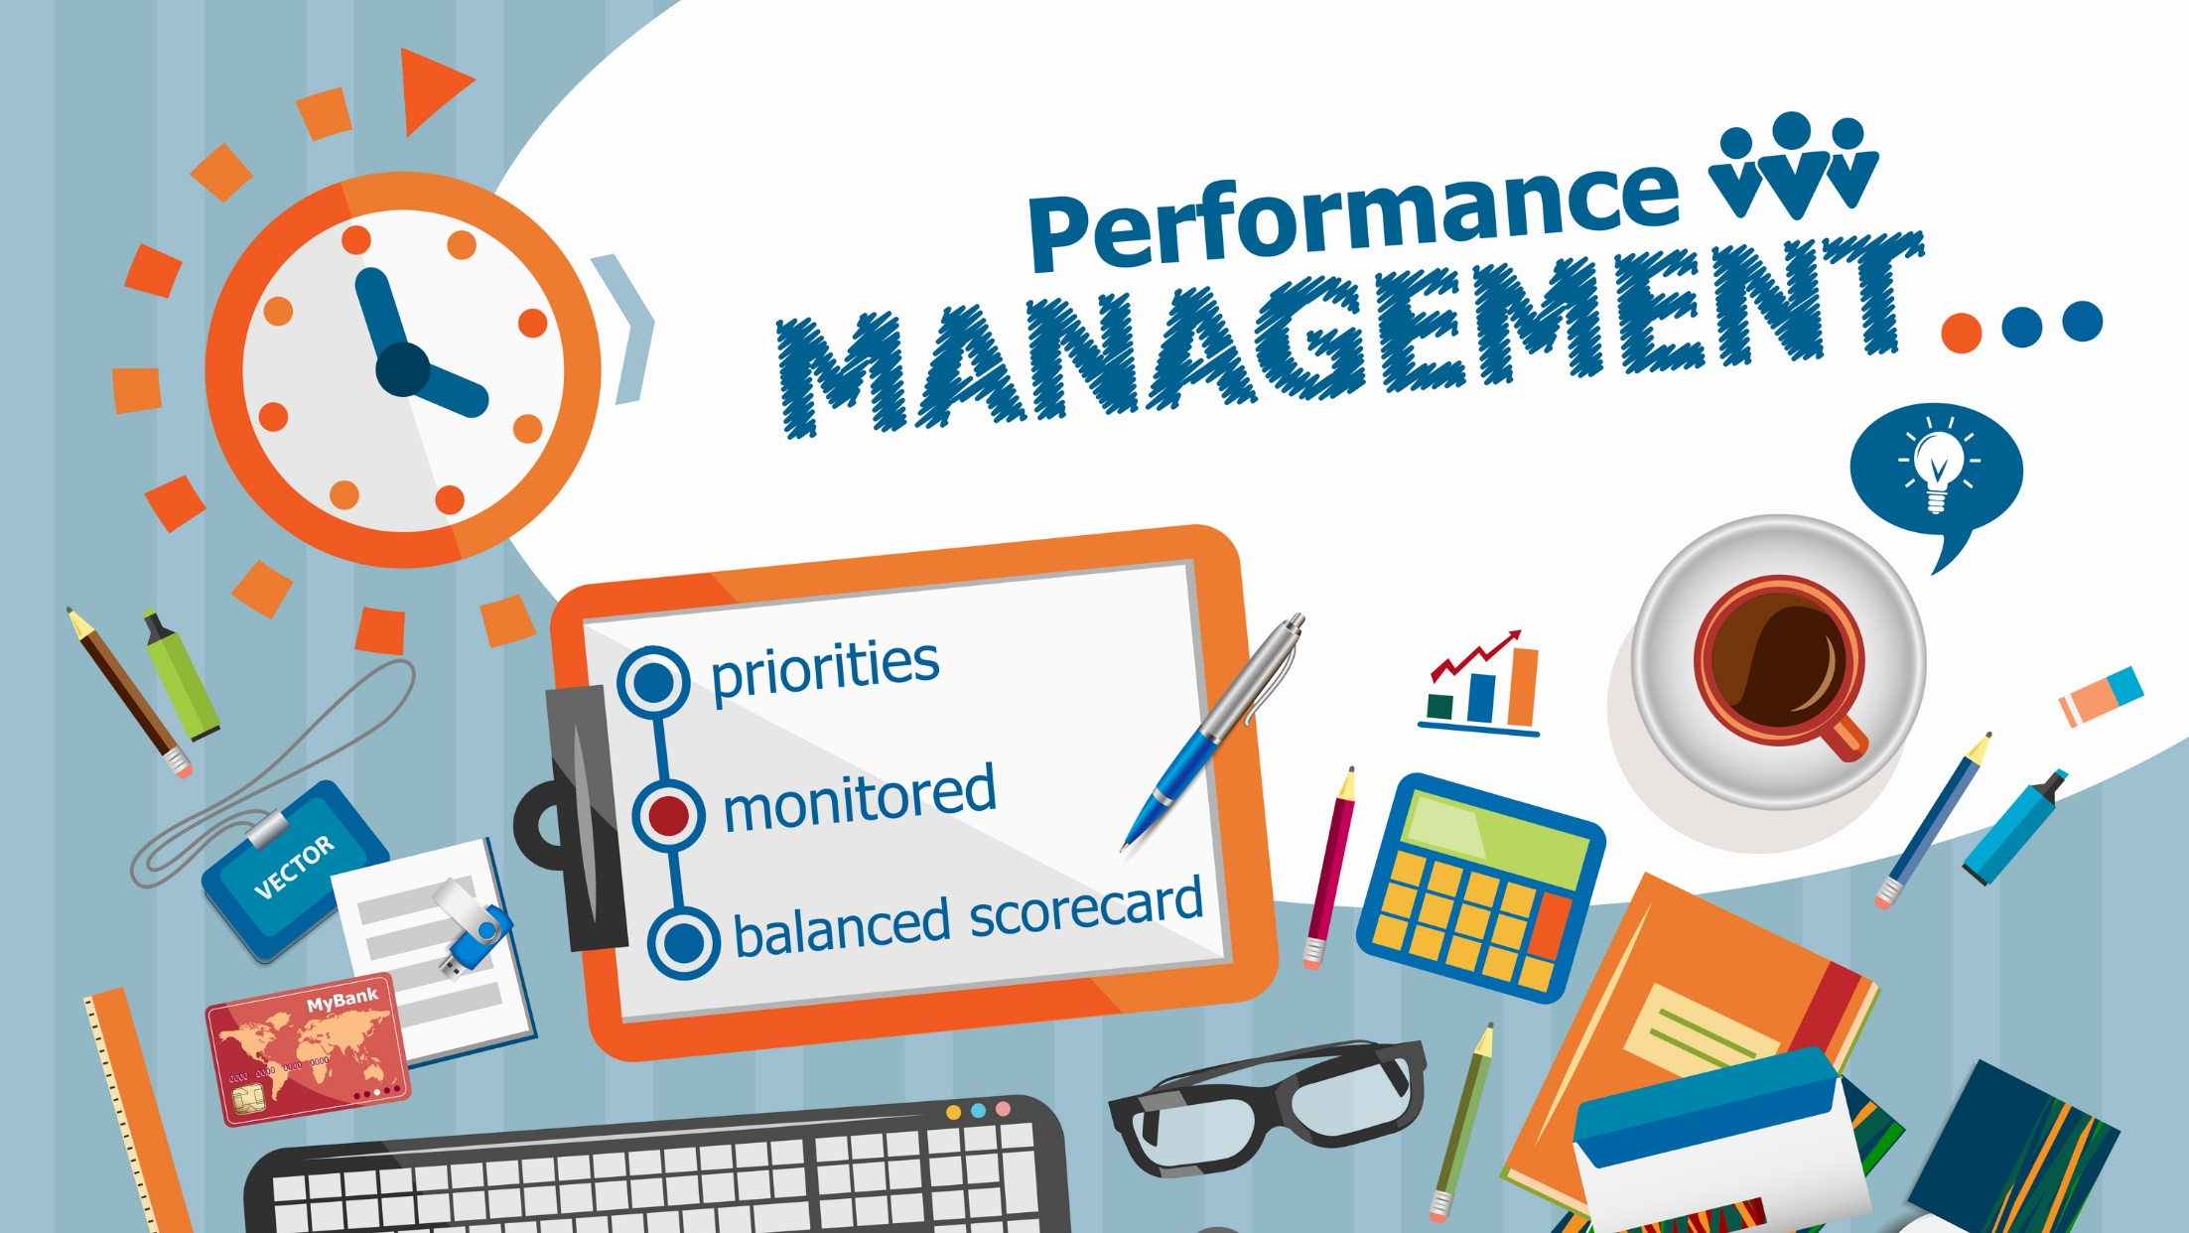
ENTERPRISE WEB APPLICATION (END TERM PROJECT NO 10)
HUMAN RESOURCE(HR) MANAGEMENT SYSTEM
MADE BY : Kaushal_20csu051
Nishchay_20csu073
Lakshay_20csu056
Aman_20csu008
This Photo by Unknown Author is licensed under CC BY-SA-NC

Slide 2
LINK OF THE GIT HUB
https://github.com/kaushal-2002/EWA_Final_project

Slide 3


OBJECTIVE :
The project facilitates an organization to manage the details of each employee, such as salary and time management etc. It also maintain the record of candidates that are being interviewed. This system designed to reduce the workload of HR and Administrative Departments.
MODULES :
a) Employee Registration
a. Login
b. Profile Update
b) Leave Management
a. Check leave status
c) Payroll Management
a. Check balance sheet/Payslip

Slide 4


SOFTWARES & WEB TECHNOLOGIES/TOOLS USED IN THE PROJECT:
STS Tool : Spring Tool Suite (STS) Spring Tool Suite is an IDE to develop Spring applications. It is an Eclipse-based development environment. It provides a ready-to-use environment to implement, run, deploy, and debug the application. It validates our application and provides quick fixes for the applications.
MAVEN : Maven is a powerful project management tool that is based on POM (project object model). It is used for projects build, dependency and documentation. It simplifies the build process like ANT. ... maven make the day-to-day work of Java developers easier and generally help with the comprehension of any Java-based project.

Slide 5
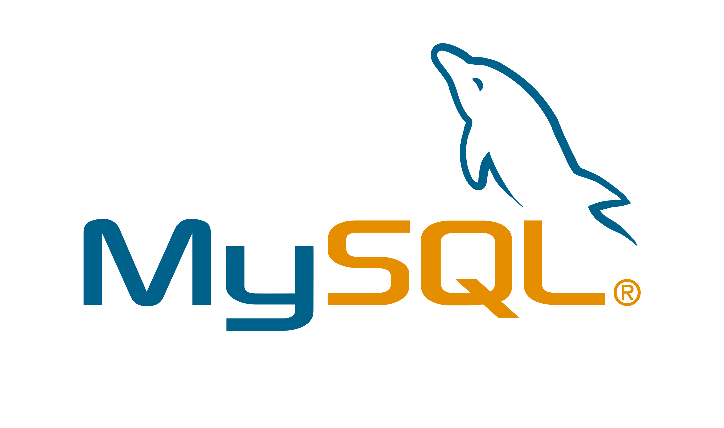
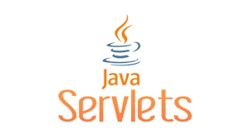

SERVLET : A servlet is a Java programming language class that is used to extend the capabilities of servers that host applications accessed by means of a request-response programming model. Although servlets can respond to any type of request, they are commonly used to extend the applications hosted by web servers.
APACHE TOMCAT : Apache Tomcat is a free and open-source implementation of the Jakarta Servlet, Jakarta Expression Language, and WebSocket technologies. Tomcat provides a "pure Java" HTTP web server environment in which Java code can run.
MYSQL : MySQL is an open-source relational database management system. Its name is a combination of "My", the name of co-founder “Michael Widenius’s” daughter, and "SQL", the abbreviation for Structured Query Language.

Slide 6


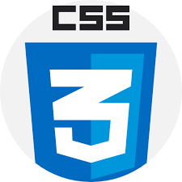
PROGRAMMING LANGUAGES USED :
JAVA: Java is a high-level, class-based, object-oriented programming language that is designed to have as few implementation dependencies as possible.
HTML : HTML (Hypertext Markup Language) is the code that is used to structure a web page and its content. For example, content could be structured within a set of paragraphs, a list of bulleted points, or using images and data tables.
CSS : Cascading Style Sheets is a style sheet language used for describing the presentation of a document written in a markup language such as HTML. CSS is a cornerstone technology of the World Wide Web.

Slide 7
Functions of an HRMS
Candidate management: Relates to employment offers to candidates and how you promote your brand to both the outside world and current employees who may wish to apply for internal jobs or make referrals. Critical for companies for which the candidate experience is a primary concern—from applying to resume management to interview scheduling to making offers, all the way through onboarding.
Employee engagement: People who are more engaged tend to produce higher-quality work and more fully adopt the company’s values and execute its vision, so how an employee connects with leadership and colleagues is important. Often, the HRMS is the route to complete a training course, acquire a new skill, develop a career path, gain recognition or become a mentor.
Employee management: There’s a reason this function is often referred to as “core HR.” Delivers a central portal to support analysis, reporting and compliance processes. It’s where you structure your workforce into organizational units, like departments or locations; define reporting relationships between managers and employees; and align payroll to accounting cost centers. It’s here where personal information is recorded and maintained, and this function is the cornerstone of efforts to offer employee self-service, maximize reporting and improve HR service delivery.

Slide 8
Payroll: This is also a primary function of the HRMS—calculating earnings from gross to net or net to gross and withholding individual deductions and issuing payments can be made just as routine as paying the rent. Payroll functions comprise benefit elections and both employee and employer costs. Full-service payroll solutions also automate tax filing and deposits. Self-service functions allow employees to make changes to elective deductions, direct deposit accounts and tax withholdings and retrieve copies of earning statements without HR assistance.

Slide 9
Benefits of an HRMS
Improved employee engagement: An HRMS is invaluable in developing and retaining talent—something HR leaders are passionate about. Within an HRMS, HR can create training curriculums, personalize learning plans and career paths and set up mentorships.
Lower back-end overhead: From an IT and capital-spending POV, the centralized nature of an HRMS—especially one sold in a fully cloud-based, software-as-a-service model—requires less hardware, data center space and IT and development staff resources for maintenance, support and training. This rationalizes IT expenditures for HR technology, requires fewer help desk staff and generally improves the satisfaction of full-time users of an HRMS, the HR team itself.
Faster recruiting: Attracting top talent and building your company’s reputation as “the place everyone wants to work” is another area HR pros are passionate about. The candidate experience, however, has been largely ignored because it’s difficult to gain insight into the job search process when postings happen outside of the company. An HRMS solves this problem by connecting recruiters and candidates electronically through job boards and mobile applications, making the process more enjoyable and efficient.

Slide 10
HRMS Features
Benefits administration: Helps HR professionals develop plans, configure eligibility rules and make payments or deposits to benefits providers. Also offers self-service open enrollment and integrates benefit costs with accounting.
Centralized employee records: Provides a single repository where all employee records are stored, updated and maintained. Allows for better reporting and lowers the costs of compliance and preparing for audits.
Learning management: These features are designed to help employees acquire or develop skills through course administration, course and curriculum development, testing and certifications. Also enables companies to roll out and track required compliance training.
Reporting and analytics: Delivers the ability to run operational reports to track HR information, complete compliance reporting, develop key performance indicators (KPIs) to measure HR process performance and embed HR metrics into financial dashboards for company-wide analysis, planning and decision-making. Also look for the ability to create ad-hoc reports.

Slide 11
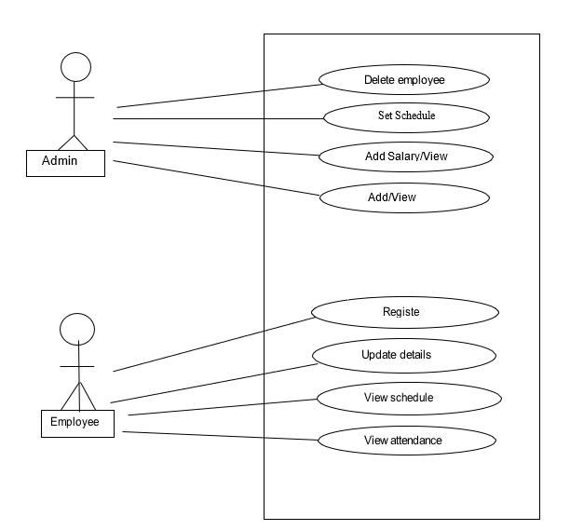

Slide 12
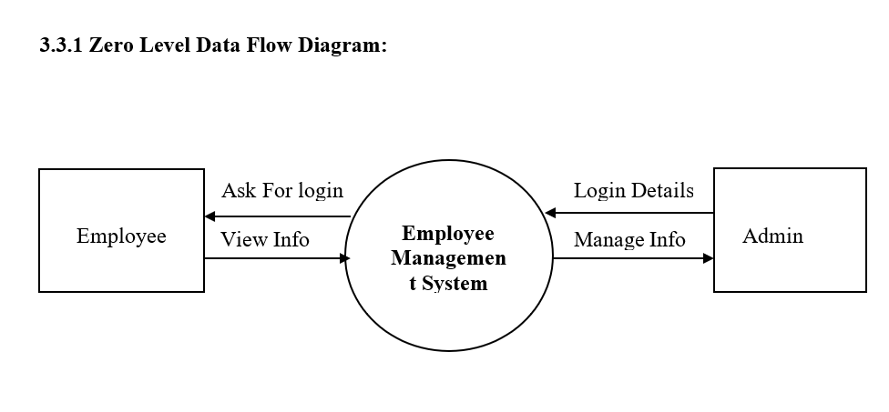
Data flow levels-

Slide 13
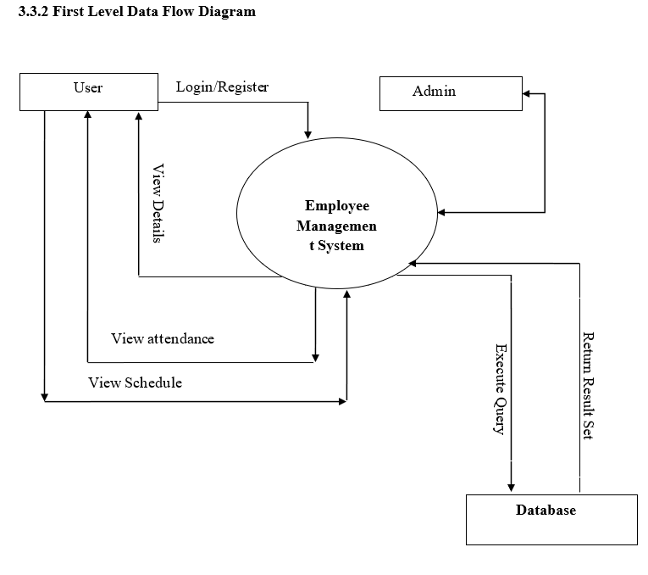

Slide 14
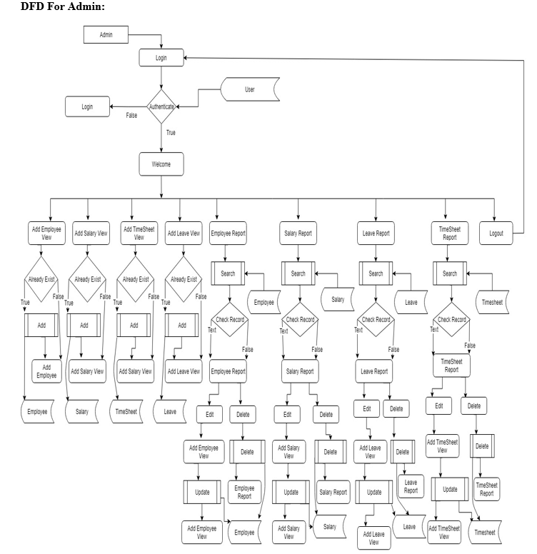

Slide 15
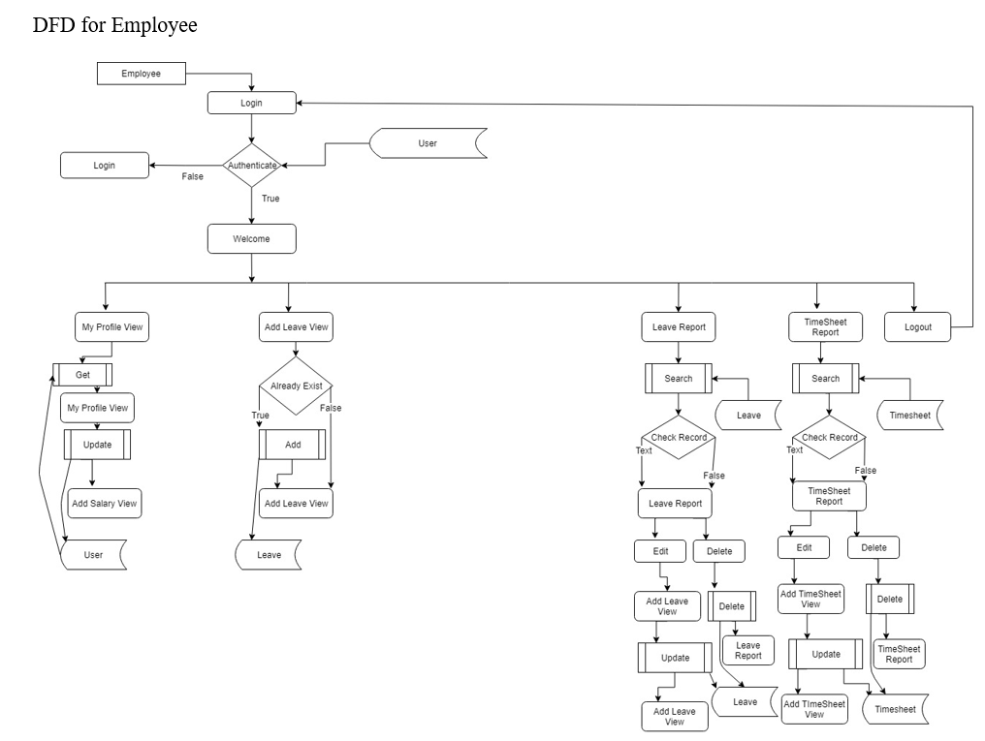

Slide 16
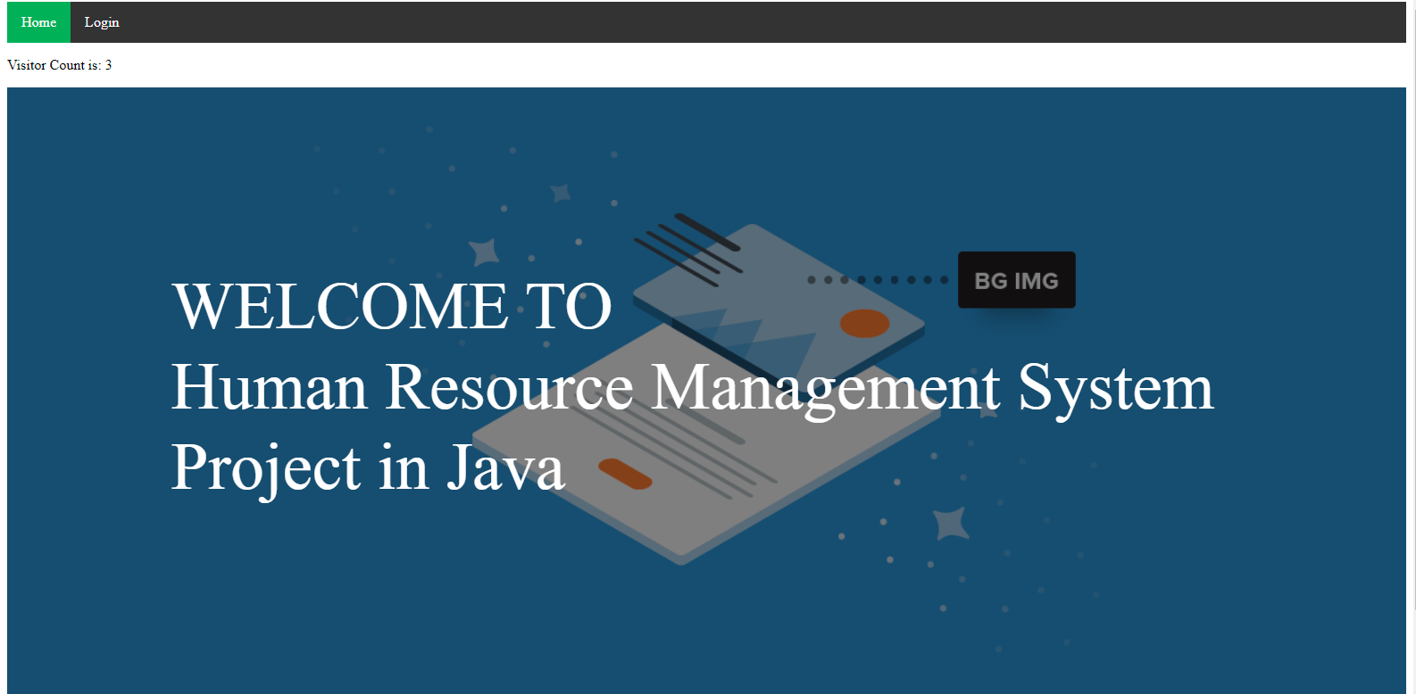

Slide 17
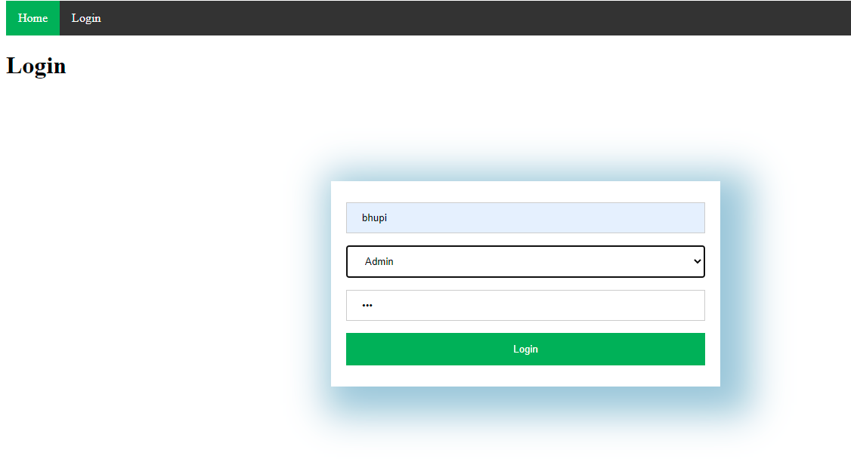

Slide 18
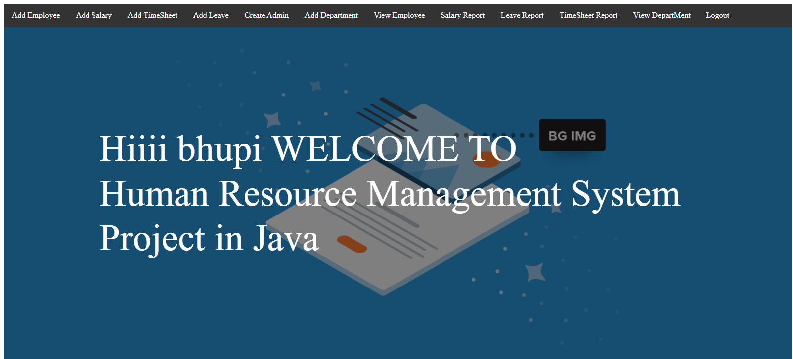

Slide 19
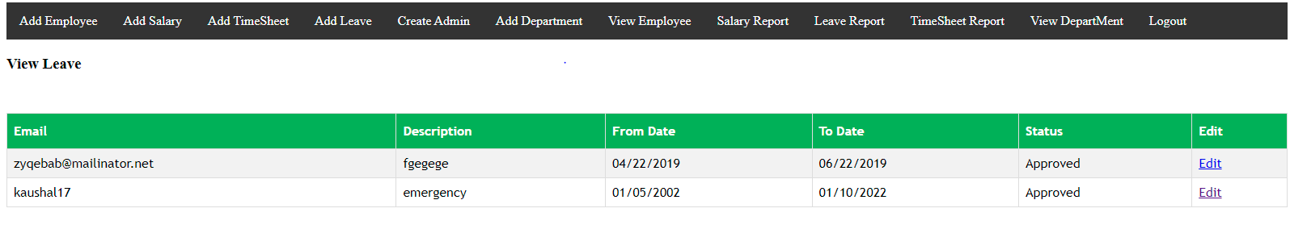

Slide 20
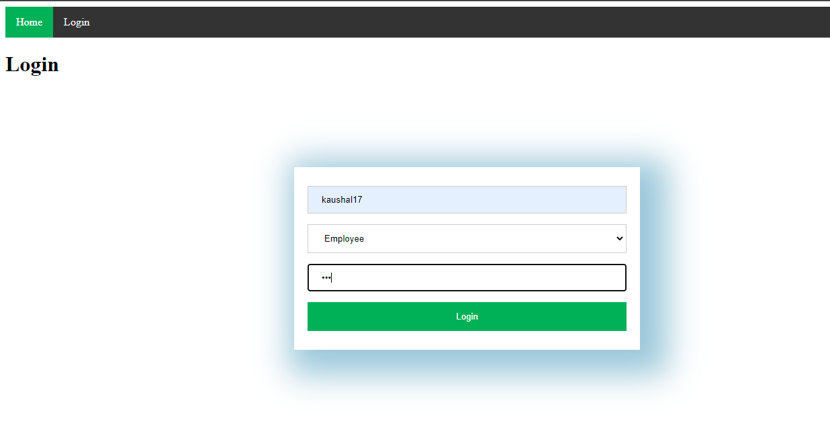

Slide 21
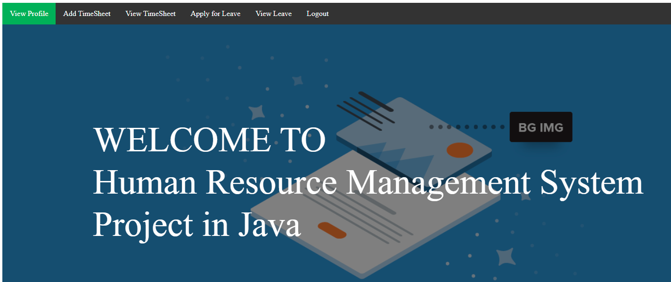

Slide 22
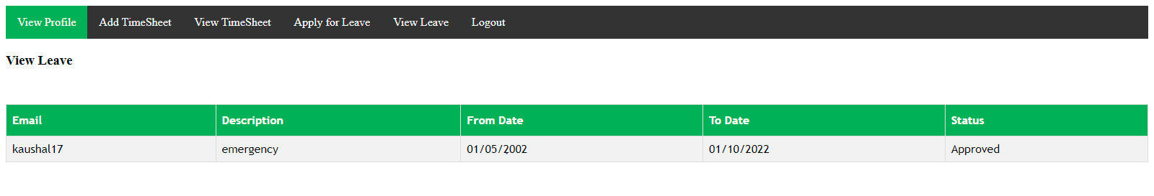

Slide 23
Work done by kaushal khurana_20csu051
create
➔ jsp files
Java file under ems.erp.controller
Java file under ems.erp.model.
Java file under ems.erp.beans.
Java file under ems.erp.util
Css
Ppt

Slide 24
Work done by Nischay verma_20csu073
Create
Java file under ems.erp.model.
Java file under ems.erp.beans.

Slide 25
Work done by Lakshay jhakar_20csu056
Create
Java file under ems.erp.util
Ppt

Slide 26
Work done by Aman Bhist_20csu008
Create
➔ Index.jsp
➔ Report

